Slide 1

DASHBOARD USING EXCEL
HR ANALYTIC
Ahmed Hamdy
More info

Slide 2
01
Start by stating the objective of the presentation

Slide 3
Objective!
Analyze the reasons for employee attrition within the company and understand how various factors like age, job role, education, and job satisfaction impact employees leaving the company.

Slide 4
02
Data Description

Slide 5
Basic Employee Information
01
03
Employee Number
Age
Unique identifier for each employee.
The employee's age.
02
04
Gender
Marital Status
The employee's gender (Male / Female).
The employee's marital status (Married, Single, Divorced).

Slide 6
Job and Employment Information
01
03
Department
Job Level
The department in which the employee works (e.g., HR, R&D, Sales).
The employee’s job level within the company.
02
04
Job Role
Business Travel
The employee's job title.
The frequency of business travel required for the job (Rarely, Frequently, Never).

Slide 7
Job and Employment Information
05
07
Years At Company
Years Since Last Promotion
The number of years the employee has worked at the company.
The number of years since the employee was last promoted.
06
08
Years In Current Role
Years With Current Manager
The number of years the employee has been in their current role.
The number of years the employee has worked with their current manager.

Slide 8
Job Satisfaction and Performance
01
03
Performance Rating
Work Life Balance
The employee’s performance rating (typically on a scale of 1 to 5).
The employee’s work-life balance (Low, Medium, High).
02
04
Job Satisfaction
Environment Satisfaction
The level of satisfaction the employee has with their job.
The employee’s satisfaction with the work environment.

Slide 9
Job Satisfaction and Performance
05
06
Job Involvement
Relationship Satisfaction
The degree to which the employee is involved in their work.
The employee’s satisfaction with their relationships at work.

Slide 10
Attrition Analysis
01
02
Attrition
attrition encode
Whether the employee has left the company (Yes / No).
Encoded values for attrition status.

Slide 11
03
General Analysis

Slide 12
General Analysis
Total Employees
Active Employees
Ex-Employees
1470 employees
1233 employees
237 employees

Slide 13
General Analysis
Attrition Ratio
Average Age
Average Job Satisfaction
16% of employees left the company
37 years
2.63 (on a scale from 1 to 5, indicating moderate satisfaction)

Slide 14
Detailed Analysis by Different Dimensions
1
Male: 63% of employees who left
2
Female: 37% of employees who left

Slide 15
Detailed Analysis by Different Dimensions
1
28-37 years: 43% of attrition
2
38-47 years: 28%
3
18-27 years: 14%
4
48-57 years: 13%
5
58-67 years: 2%

Slide 16
Detailed Analysis by Different Dimensions
1
Laboratory Technician: 26% of attrition
2
Sales Executive: 24% of attrition
3
Research Scientist: 20% of attrition
4
Sales Representative: 14%

Slide 17
Detailed Analysis by Different Dimensions
1
Bachelor's Degree: 41.77% of attrition
2
Master's Degree: 24.47% of attrition
3
Associate's Degree: 18.57% of attrition
4
High School: 13.08% of attrition
5
Doctoral Degree: 2.11% of attrition

Slide 18
Detailed Analysis by Different Dimensions
1
Travel_Rarely: 66% of attrition
2
Travel_Frequently: 29%
3
Non-Travel: 5%

Slide 19
Detailed Analysis by Different Dimensions
1
Married: 46% of attrition
2
Single: 32%
3
Divorced: 22%

Slide 20
Detailed Analysis by Different Dimensions
1
R&D: 56% of attrition
2
Sales: 39%
3
HR: 5%

Slide 21
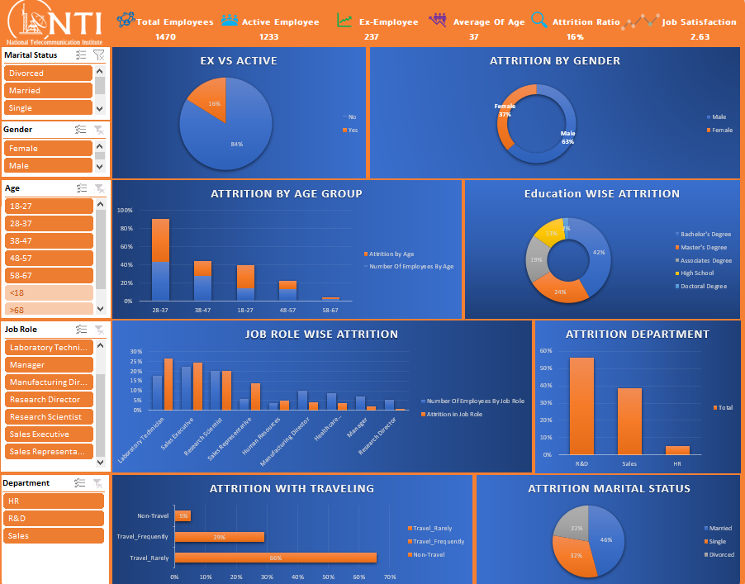
Dashboard

Slide 22
04
Conclusions

Slide 23
Conclusions
Age and Education
Job Role
Employees in the 28-37 age group are more likely to leave, especially those with Bachelor's and Master's degrees.
Roles like Laboratory Technician and Sales Executive have higher attrition rates.

Slide 24
Conclusions
Business Travel
Department
Employees who travel rarely are more likely to leave.
The R&D department shows the highest attrition rate.

Slide 25
Recommendations
Improve Work Environment
Focus on enhancing employee satisfaction in high-attrition departments like R&D and Sales.
Review Business Travel Policies
Reducing travel may help alleviate employee stress and lower attrition.
Focus on Younger Employees
Develop retention strategies for employees in the younger age group (28-37).
Increase Training and Promotion Opportunities
Provide more growth opportunities for employees with higher education levels.

